Slide 1


Blog Post Popularity Prediction
Purushartha Singh
pxs288@psu.edu
MS (CSE), Dept. of Computer Science and Engineering
Notes:
Hi I am Purushartha Singh, a Masters student from the CSE department and my final project is about prediction of Blog post popularity.

Slide 2
About the dataset
Supervised regression which uses the features of the blog post to predict the total number of comments which the blog post would receive over the next 24 hours
Data set information:
60021 data points
281 total features
Dependent variable range: 0-1424
Features include statistics of the post content, metadata of the post, bag of words representation of post content, and comment history statistics.
Baseline was established using the methodology from the original paper by Buza et al.
Buza, K. (2014). Feedback Prediction for Blogs. In Data Analysis, Machine Learning and Knowledge Discovery (pp. 145-152). Springer International Publishing.
Notes:
.

Slide 3
Motivation
Use of ML for social media tasks is a very pertinent application.
Opportunity to use machine learning for prediction of blog post popularity.
Can apply multiple aspects of the course for the same project.

Slide 4
Methodology
Baseline using Random forests model
Used other regression models on the original data for R2 and MSE metrics
Feature selection methodologies to reduce total number of features
Results with the selected features using all the models
Results using Dense Neural Network
Regression Models:
Random forests
Linear Regression
Gradient boosting
ADA boost
Dense Neural Network (Keras API)

Slide 5
Baseline and original Data Results
Notes:
The baseline is highlighted in white for these graphs. As one can see, the Random forest regression model performed the best out of all the regression models in all 4 baseline metrics.

Slide 6
Baseline and original Data Results
Regression models | R2 Score | STD
Linear | 0.3040 | 25.443
Random Forests | 0.4237 | 23.152
Gradient Boosting | 0.4233 | 23.160
AdaBoost | 0.3806 | 23.796
Notes:
For the R2 metric for assessment, Surprisingly, the linear regression model performed the best for this assessment

Slide 7
Baseline and original Data Results
Regression models | R2 Score | STD
Linear | 25.4433 | 25.443
Random Forests | 23.1537 | 23.152
Gradient Boosting | 23.1617 | 23.160
AdaBoost | 24.0035 | 23.796
Notes:
For the Root mean square metric for assessment, Surprisingly, the linear regression model performed the best for this assessment

Slide 8
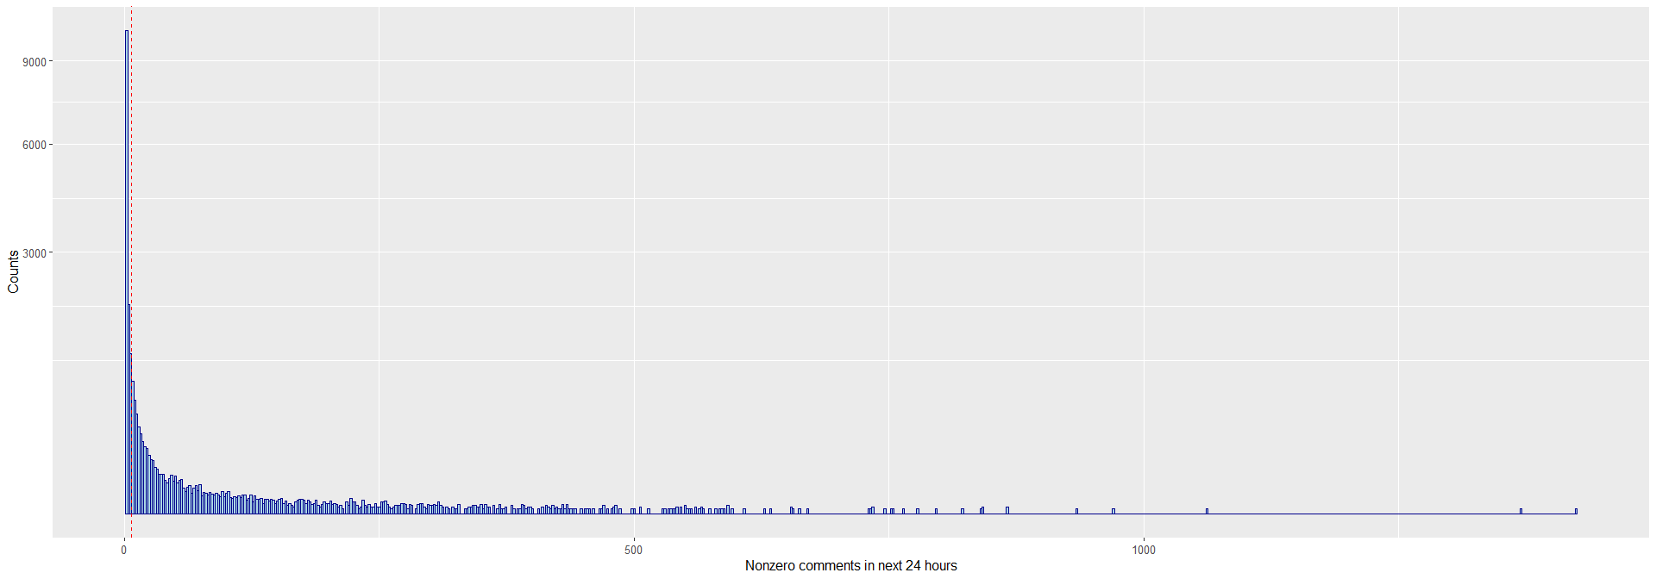
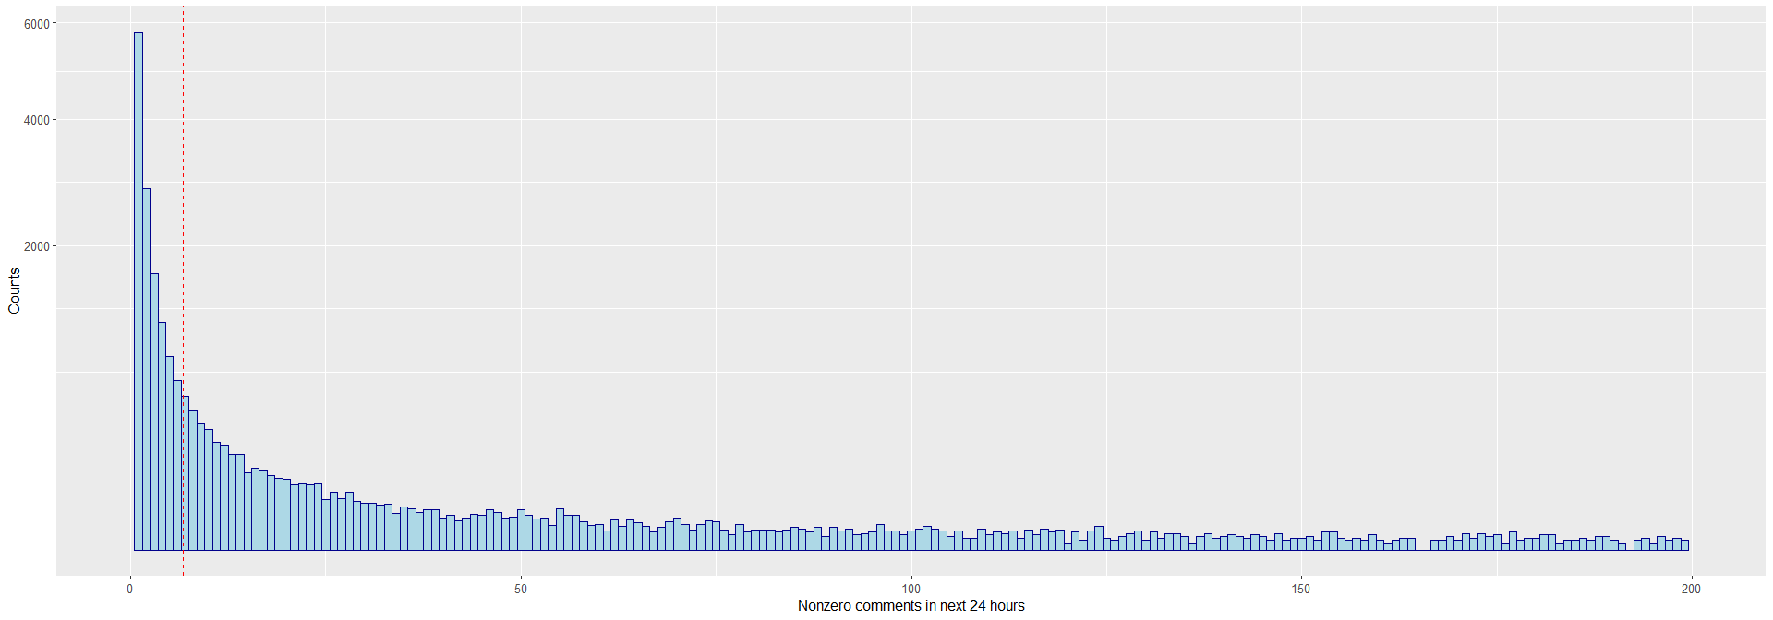
Data Assessment - Distribution
The dependent variable was highly skewed with a mean of 6.765 (denoted by red line in Figure 1)
Certain features showed high correlation with the dependent variable in the preliminary analysis
The total frequency of dependent variable (above) and a zoomed in frequency of data for range up to 200 (below)
Notes:
To improve on the results, the data was analyzed in depth.
The dependent variable was highly skewed towards the lower range and you can see the distribution of the frequency in the graphs. The upper graph has the entire range and the lower graph only looks at values up to 200. The overall mean is denoted by the red line in the lower graph.
Comparison of correlations of different features was looked at as well.

Slide 9
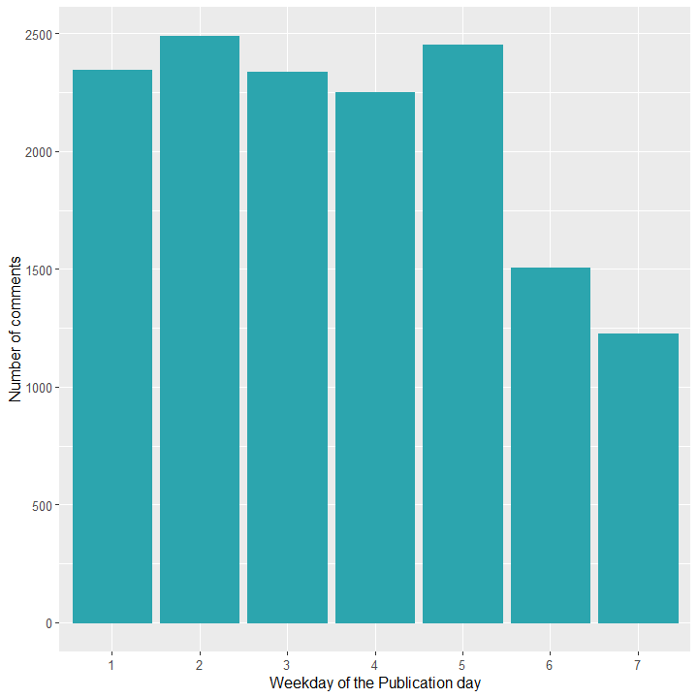
Data Assessment – Day of the Week
The number of comments seemed to indicate that posts published on the weekend had a lower count
The feature did not correlate with any other feature
Day of the week frequency of comments
Notes:
Day of the week was a feature which strongly indicated that the weekend posts received less number of overall comments. More so, the feature did not correlate with the other features of the dataset which further indicated a good correlation with the dependent variable.

Slide 10
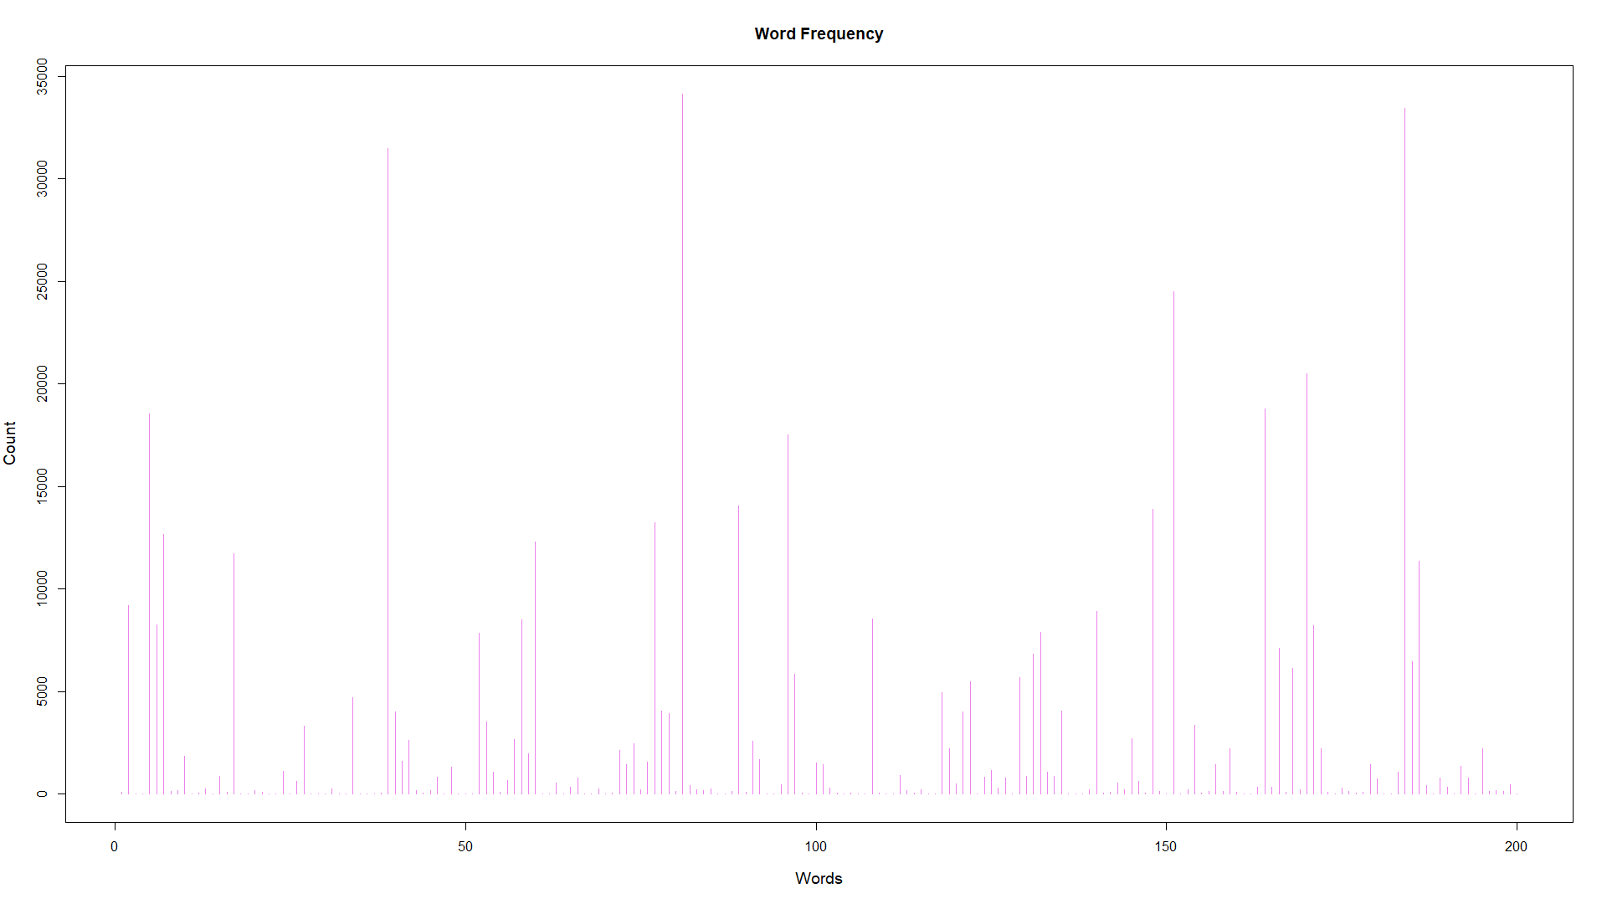
Data Assessment – Word Frequency
The feature set has 200 Bag of Word counts for the most frequent words in the blog text.
The frequency over the dataset ranges from 4 to 34k for these words.
Tf-Idf was used to normalize these features to reduce the range drastically (3e-4 to 1547)
Sum of Word frequency of the BoW features
Notes:
Word frequency of the BoW features was assessed in the dataset. The higher frequency words were not representative of relevant information as they were mostly stop words. To mitigate this, the inverse document frequency measure was used to normalize the features for each word which is the ratio of the term frequency of a word in the dataset divided by the frequency of documents the word appears in.

Slide 11
Feature selection
28 features were selected out of 281 using the filter method (top 10%)
Recursive Feature Elimination wrapper method with cross-validation on both the reduced feature sets.
The modified Tf-Idf counts for Bag of words representations were used instead of the original data
Reduced the total number of features for the second set of experiments to 10 features.
The data was also randomly shuffled for one set of experiments
Notes:
The analysis of features from the previous slides was consistent with the filter method feature selection which was done using the correlation between the feature and target value.
This eliminated a majority of the bag of words representations for the stop words and other irrelevant metadata.
Further elimination through the recursive wrapper method brought the number of features down to 10.
These features included information such as past number of comments on the post, and statistics on the parent websites number of comments.

Slide 12
Top Features
Description of the best features based on feature selection
Statistics about the average, standard deviation, min, max, and median of the source of the post.
Total number of comments before the observation of next 24 hours of comments
Comments in the last 24 hours.
Number of comments in the first 24 hours after the post was published
Length of time between the publication of the post and observation
Length of blog post

Slide 13
Results of feature selection

Slide 14
Results of feature selection

Slide 15
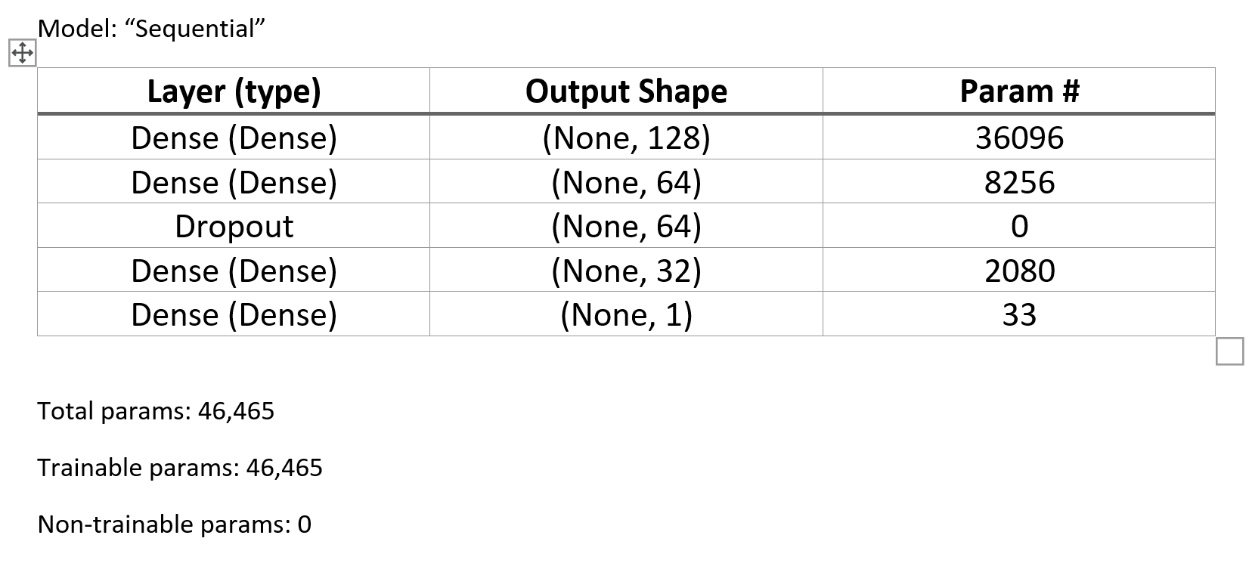
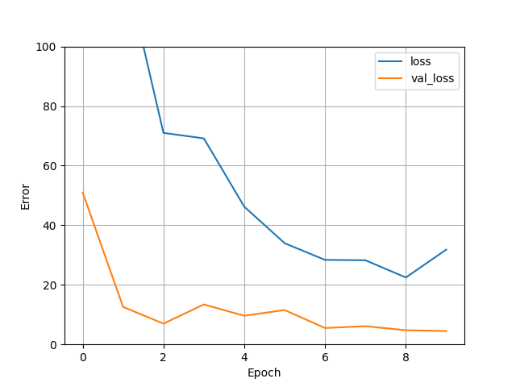
Dense Neural Network Results
A neural Network with 4 Dense layers and one dropout layer was trained using ADAM optimizer
The model was run for 10 epochs with an alpha = 0.001.
The results were better than all other models by a significant amount

Slide 16
Dense Neural Network Results

Slide 17
Discussion
Random Forest Performed the best when using PCA
Linear regression performed best when used with filters
Neural Network performed the best out of all the models by a fair margin
Neural Network required a lot of tuning to achieve the result
The baseline scores were very reliably beaten

